Slide 1
Anxiety and Erectile Dysfunction
Student’s Name
Student Number
Section Number
Professor’s Name

Slide 2
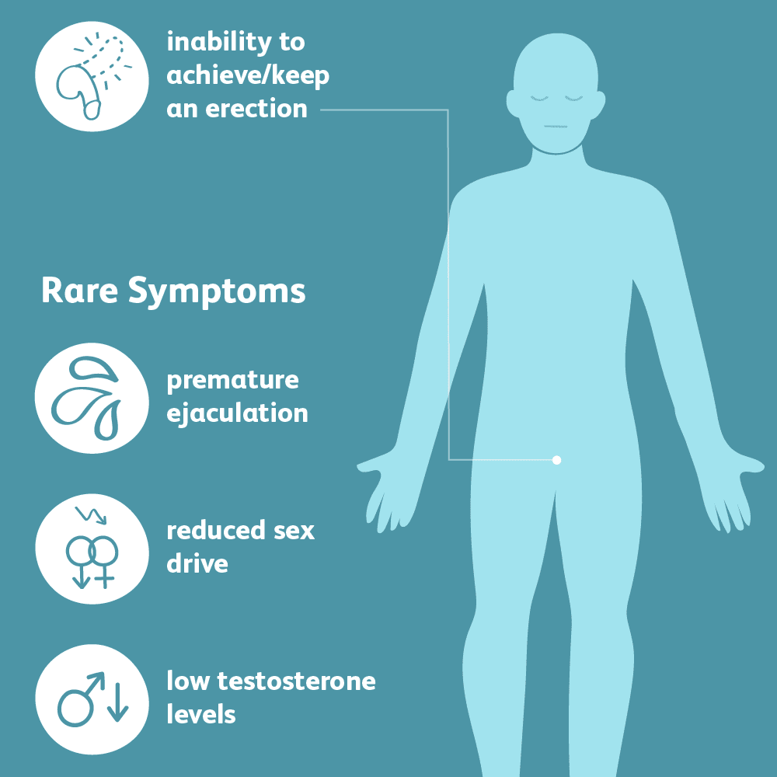
Introduction
Sexual performance
Anxiety
Erectile dysfunction(ED)
Achieving erection
Maintaining erection
Image: Erectile dysfunction
Notes:
Anxiety plays an integral part in the sexual performance in individuals. Anxiety reduces the urge to perform optimally during sexual intercourse. Erectile dysfunction can affect men of any age group, but is prevalent in the later stages of life. However, the psychological causes of ED prevents the victims from achieving erection or maintaining the same.

Slide 3
Cont.
Mental and visual associations
Stressed blood vessels
Disruption of the nervous system
Right messages from the brain
Blood flow to the penis
Notes:
From a psychological standpoint, ED can be as a result of mental or visual associations that disrupt the nervous systems. In this regard, the blood vessels that facilitate the erection process become stressed. Anxiety interrupts how the brain sends arousal messages to the penis to facilitate the extra flow of blood.

Slide 4
Behavioral Change
Behavioral changes that lower sexual performance
Affects both young men and older ones
Cause of psychological ED:
Job Loss
Familial dysfunction
Financial burden, etc.
Notes:
Anxiety and emotional distress can lead to behavioral changes that causes anxiety during sexual intercourse . Psychological ED affects 90% of most young men as well as teenagers. Anxiety can be as a result of job loss, familial dysfunction, financial burden, etc.

Slide 5
Performance Anxiety
Stress over body images.
Negative thoughts
Induction of doubts
Pressure to please one’s partner
Insecurity
Notes:
Performance anxiety occurs when men feel stressed over body images and their capabilities to please their partners. Performance anxiety is as a result of negative thoughts that clouds the mind of the victim; making them doubtful of their sexual capabilities. The pressure to please the other partner leads to insecurity that inhibits optimal sexual performance.

Slide 6
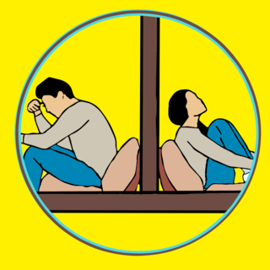
Psychogenic ED
Adrenaline-mediated conditions
Neurogenic factors
Functional malfunctions
Collagenized muscles
Reduced blood flow
Image: Anxiety
Notes:
Non-organic ED occurs as a result of adrenaline-mediated conditions that make persons achieve or maintain their erections. Neurogenic factors cause deficits in nerve signaling to the nerve endings. The condition causes functional malfunctions with regards reduced reflexes of the nerves on the penis. The smooth muscles on the penis become collagenized due to reduced blood flow to the penis (Yafi et al., 2017).

Slide 7
Empirical and Statistical Data
Mental factors as a contributor of ED.
Anxiety as a risk factor
Anxiety and ED are self-reinforcing
Neurological effects
25% men that had suffered anxiety experienced ED
Notes:
Empirical evidence shows that mental factors contribute largely to ED in the United States (U.S). Anxiety and depression are notable risk factors for the condition with regards to the neurological effects that they induce in the victims. ED and anxiety are self-reinforcing since one must exist for the other to occur. Statistical evidence shows that 25% of males that have experienced anxiety have experienced episodes of ED (Gao, 2019).

Slide 8
Perceptual Representations
Size of the penis
Ideal body images
Loss of sexual desires
Difficulties in maintaining erection
Misled feminine ideologies
Notes:
Some men form perceptual representations on the ideal size of the penis, ands start developing negative thoughts if they do not fit the general perceptions. As a result, the victims start becoming worried about their sizes. The phenomenon leads to loss of sexual desires, or keeping their erections. Women have not also helped in the mitigation since they unknowingly mount the pressures based on their perceptions on ideal penis size that should promote optimal sexual satisfaction.

Slide 9
Symptoms of ED
Premature ejaculation
Blocked ejaculation
Delayed ejaculation
Trouble achieving erection
Trouble maintaining erection
Notes:
The symptoms of psychological ED include premature ejaculation that occur as a result of reduced emotional urge. Delayed and blocked ejaculation some times arises when a person is experiencing extreme anxiety or sexual disorders. Problems of achieving erections due to the brain being unable to send appropriate messages to the penis. The same applies with the challenges of maintain a strong erection for a considerable period.

Slide 10
Seeking Help
Early interventions
Professional care and assistance
Anxiety management strategies
Overcoming of fears and negative thoughts
Assessment of other factors
Notes:
Persons that have been diagnosed with ED should seek help as early as possible to mitigate long-term effects. Seeking help from psychotherapies enables the victims to overcome the fears that induce anxiety in them during sexual intercourse. The medical practitioners equip the victims with strategies that they can use to remove the negative thoughts. Also, it helps individuals assess other factors that can be affecting their ability to perform.

Slide 11
Treatment
Treatment options:
Mediation
Sex education
Talk therapies
Change in lifestyle
Notes:
The treatment options that can be used to treat psychological ED include meditation that helps the victims find their inner peace. Also, sex education can be used to treatment appropriate sexual behaviors. Talk therapies can also be used to help the victims manage their stress and other life concerns. Also, lifestyle changes, including improving physical exercise and dietary habits.

Slide 12
Guided Imagery
Guided imagery and performance anxiety
Simulation of trance-like environments
Listening to a vivid script
Overcoming mental problems
Tapping into the unconscious mind
Notes:
Guided imagery is an effective way of overcoming psychological ED associated with performance anxiety. The intervention entails simulating a trance-like environments. The victims are required to listen to a script that describes a detailed sexual scenario. As a result, the body can overcome mental challenges by tapping into the unconscious mind.

Slide 13
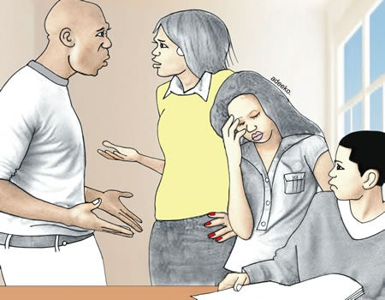
Cognitive Behavioral Treatment
Fear of penetration and avoidance
Fear-induced cognitions
Systematic desensitization
Behavioral hierarchies
Sexual response awareness
Image: Familial problems
Notes:
The approach aims to reduce fear of penetration, avoidance, and anxiety. Various behavioral mechanisms are used to treat fear-induced cognitions. The treatment entails systematic desensitization by highlighting the behavioral hierarchies that are related to sexual activities (Kane et al., 2019). Mindfulness-based interventions help target anxiety factors that increase the victim’s awareness of sexual responses.

Slide 14
Phosphodiesterase Inhibitor
Revolutionary treatment in phosphodietsterase inhibitor.
Highly recommended for physicians
Efficacy of 60-80%.
Penile neurovascular response
Improvement of blood flow
Notes:
The inhibitor has revolutionized the treatment of ED. The intervention is recommended for patients suffering from psychological ED based on its efficacy that averages between 60% and 80%. The treatment increases the penile neurovascular response in men; therefore, improving blood flow to the penis.

Slide 15
Summary
Anxiety disorders cause ED.
ED is the inability to achieve or maintain an erection.
Anxiety can be caused by work-related and personal factors,
It affects brain’s ability to send the right messages to the penis.
Neural challenges
Notes:
I learned that ED can be as a result of psychological factors related to anxiety. The psychological factors affects men’s ability to achieve or maintain their erections. Performance anxiety can be as a result of work-related factors or personal problems. As a result, the factors prevents the brain from sending the right signals to the nerves on the penis.

Slide 16
Conclusion
ED can be treated
ED is as a result of perceptual pedagogies
Mental representations induce negative energy
Individuals start becoming anxious to perform
There is a need to change the perceptions that are prevalent in society
Notes:
Psychological ED can be treated with the right interventions such guided imagery, mediation, inhibitor induction, etc. ED is as a result of perceptual pedagogies that induce negative thoughts in the minds of the victims. Victims strive to align their sexual responses to the expectation created in society.

Slide 17
References
Gao, J., Zhang, Y., Li, H., Gao, P., & Zhang, X. (2020, February 10). Different Evaluations Exist between Men with Erectile Dysfunction and Their Female Partners When Using Erectile Hardness Model: An Interesting, Observational, and Cross-Sectional Field Survey. BioMed Research International. https://www.hindawi.com/journals/bmri/2020/2302348/‌
Kane, L., Dawson, S. J., Shaughnessy, K., Reissing, E. D., Ouimet, A. J., & Ashbaugh, A. R. (2019). A review of experimental research on anxiety and sexual arousal: Implications for the treatment of sexual dysfunction using cognitive behavioral therapy. Journal of Experimental Psychopathology, 10(2). https://doi.org/10.1177/2043808719847371
Yafi, F. A., Jenkins, L., Albersen, M., Corona, G., Isidori, A. M., Goldfarb, S., Maggi, M., Nelson, C. J., Parish, S., Salonia, A., Tan, R., Mulhall, J. P., & Hellstrom, W. J. (2016). Erectile dysfunction. Nature reviews. Disease primers, 2, 16003. https://doi.org/10.1038/nrdp.2016.3

Slide 18
Graphics
Anxiety
Erectile dysfunction
Familial problems

